Slide 1
SS ZG 566 Secure Software Engineering
T V Rao

Slide 2
Security Requirements Engineering – Part 1 RL 4.1.1

Slide 3
Importance of Requirements Engineering
Some studies have shown that requirements engineering defects cost 10 to 200 times as much to correct once the system has become operational than if they were detected during requirements development.
According to Charette[2005], Requirements problems are among the top causes of the following undesirable phenomena
Projects are significantly over budget, go past schedule, have significantly reduced scope, or are cancelled
Development teams deliver poor-quality applications
Products are not significantly used once delivered

Slide 4
Requirements Engineering Challenges
Requirements Engineering on individual projects often suffers from the following problems:
Requirements identification typically does not include all relevant stakeholders and does not use the most modern or efficient techniques.
Requirements are often statements describing architectural constraints or implementation mechanisms rather than statements describing what the system must do.
Requirements are often directly specified without any analysis or modeling. When analysis is done, it is usually restricted to functional end-user requirements, ignoring
quality requirements such as security,
other functional and nonfunctional requirements, and
architecture, design, implementation, and testing constraints.

Slide 5
Requirements Engineering Challenges
Requirements specification is typically haphazard, with specified requirements being
ambiguous,
incomplete (e.g., nonfunctional requirements are often missing),
inconsistent,
not cohesive,
infeasible,
obsolete,
neither testable nor capable of being validated, and
not usable by all of their intended audiences.
Requirements management is typically weak, with ineffective forms of data capture
e.g., in one or more documents (rather than in a database or tool) and missing attributes.
often limited to tracing, scheduling, and prioritization, without change tracking or other configuration management.

Slide 6
Quality Requirements
Project teams often neglect quality requirements, such as performance, safety, security, reliability, and maintainability.
Developers of certain kinds of mission-critical systems and systems in which human life is involved, such as the space shuttle, have long recognized the importance of quality requirements and have accounted for them in software development.
In many other systems, however, quality requirements are treated in an inadequate way. Hence we see the failure of software associated with power systems, telephone systems, unmanned spacecraft, and so on.
This inattention to quality requirements is exacerbated by the desire to keep costs down and meet aggressive schedules.

Slide 7
Security Requirements Engineering
According to BSI[09], if security requirements are not effectively defined, the resulting system cannot be evaluated for success or failure prior to its implementation
Operational environments and business goals often change dynamically, with the result that security requirements development is not a one-time activity.
Requirements engineering research and practice pay a lot of attention to the functionality of the system from the user’s perspective, but little attention is devoted to what the system should not do [Bishop 2002]

Slide 8
Security Requirements Engineering
Users have implicit assumptions for the software applications and systems to be secure and are surprised when they are not. These user assumptions need to be translated into security requirements for the software systems when they are under development.
It is important for requirements engineers to think about the attacker’s perspective and not just the functionality of the system from the end-user’s perspective.
An attacker is not particularly interested in functional features of the system, unless they provide an avenue for attack. Instead, the attacker typically looks for defects and other conditions outside the norm that will allow a successful intrusion to take place.

Slide 9
Security Is Not a Set of Features
Security features such as password protection, firewalls, virus detection tools etc. are, in fact, not security requirements.
They are rather implementation mechanisms that are intended to satisfy unstated requirements, such as authenticated access
A systematic approach to security requirements engineering will help avoid the problem of generic lists of features and take into account the attacker’s perspective.
No convenient security pull-down menu that will let you select “security” and do the needful.

Slide 10
Thank You!

Slide 11
SS ZG 566 Secure Software Engineering
T V Rao

Slide 12
Security Requirements Engineering - Part 2 RL 4.1.2

Slide 13
Security Is Not a Set of Features
Security is an emergent property of a system, not a feature
Because security is not a feature, it cannot be bolted on after other software features are codified, nor can it be patched in after attacks have occurred in the field. Instead, security must be built into the product from the ground up
Most cost-effective approach to software security incorporates thinking beyond normative features and maintains that thinking throughout the development process
Every time a new requirement, feature, or use case is created, the developer or security specialist should spend some time thinking about how that feature might be unintentionally misused or intentionally abused

Slide 14
Thinking Beyond Normal
When we design and analyze a system, we’re in a great position to know our systems better than potential attackers do.
We can leverage this knowledge to the benefit of security and reliability, by asking and answering the critical questions:
Which assumptions are implicit in our system?
Which kinds of things make our assumptions false?
Which kinds of attack patterns will an attacker bring to bear?

Slide 15
Thinking like an attacker
System’s creators are not the best security analysts of that system.
‘Thinking like an attacker’ is extremely difficult for those who have built up a set of implicit assumptions
System Creators make excellent subject matter experts (SMEs).
Together, SMEs and security analysts can ferret out base assumptions in a system under analysis and think through the ways an attacker will approach the software

Slide 16
Creating Useful Misuse Cases
Misuse cases is to decide and document a priori how software should react to illegitimate use
Unlike the functional requirements, designers/developers play the role of user and explain design and underlying assumptions to security expert documents
To guide brainstorming, software security experts ask many questions of a system’s designers to help identify the places where the system is likely to have weaknesses. This activity mirrors the way attackers think.
The brainstorming covers user interfaces, environmental factors, and events that developers assume a person can’t or won’t do
“Users can’t enter more than 50 characters because the JavaScript code won’t let them”
“Users don’t understand the format of the cached data, so they can’t modify it.”

Slide 17
Misuse vs. Abuse
According to Chun Wei,
Misuse cases are defined as “behavior that the system/entity owner does not want to occur”
An interaction results in a session key being revealed to an actor who should not see the session key
Abuse cases are defined as “… where the results of the interaction are harmful to the system …”
the actor posts the session key on a public website, then an abuse case takes place
But some authors do not distinguish

Slide 18
Specifying Abuse Cases
The process of specifying abuse cases makes a designer very clearly differentiate appropriate use from inappropriate use.
The security expert/designer must ask the right questions:
How can the system distinguish between good input and bad input?
Can it tell whether a request is coming from a legitimate application or from a rogue application replaying traffic?
where might a bad guy be positioned? On the wire? At a workstation? In the back office?
Any communication line between two endpoints or two components is a place where an attacker might try to interpose himself or herself
what can this attacker do in the system? Watch communications traffic? Modify and replay such traffic? Read files stored on the workstation? Change registry keys or configuration files? Be the DLL?
Trying to answer such questions helps software designers explicitly question design and architecture assumptions, and it puts the designer squarely ahead of the attacker by identifying and fixing a problem before it’s ever created.

Slide 19
Thank You!

Slide 20
SS ZG 566 Secure Software Engineering
T V Rao

Slide 21
CMU SQUARE Process Model RL 4.2.1

Slide 22
SQUARE Process Model
Security Quality Requirements Engineering (SQUARE) is a process model that was developed at Carnegie Mellon University [Mead 2005].
SQUARE provides a means for eliciting, categorizing, and prioritizing security requirements for information technology systems and applications.
The focus of the model is to build security concepts into the early stages of the SDLC. It can also be used for documenting and analyzing the security aspects of systems once they are implemented in the field and for steering future improvements and modifications to those systems.
The SQUARE work is supported by the Army Research Office through grant (“Perpetually Available and Secure Information Systems”) to Carnegie Mellon University’s CyLab.

Slide 23
SQUARE Process Steps
1. Agree on definitions
2. Identify security goals
3. Develop artifacts to support security requirements definition
4. Perform (security) risk assessment
5. Select elicitation techniques
6. Elicit security requirements
7. Categorize requirements as to level (e.g., system, software) and whether they are requirements or other kinds of constraints
8. Prioritize requirements
9. Inspect requirements

Slide 24
SQUARE Process Steps
No | Step | Input | Techniques | Participants | Output
1 | Agree on definitions | Candidate definitions from IEEE and other standards | Structured interviews, focus group | Stakeholders, requirements engineers | Agreed-to definitions
2 | Identify security goals | Definitions, candidate goals, business drivers, policies and procedures, examples | Facilitated work session, surveys, interviews | Stakeholders, requirements engineers | Goals
3 | Develop artifacts to support security requirements definition | Potential artifacts list (e.g., scenarios, misuse cases, templates, forms) | Work session | Requirements engineers | Needed artifacts: scenarios, misuse cases, models, templates, forms

Slide 25
SQUARE Process Steps
No | Step | Input | Techniques | Participants | Output
4 | Perform (security) risk assessment | Misuse cases, scenarios, security goals | Risk assessment method, analysis of anticipated risk against organizational risk tolerance, including threat analysis | Requirements engineers, risk expert, stakeholders | Risk assessment results
5 | Select elicitation techniques | Goals, definitions, candidate techniques, expertise of stakeholders, organizational style, culture, level of security needed, cost–benefit analysis | Work session | Requirements engineers | Selected elicitation techniques

Slide 26
SQUARE Process Steps
No | Step | Input | Techniques | Participants | Output
6 | Elicit security requirements | Artifacts, risk assessment results, selected techniques | QFD, Joint Application Development, interviews, surveys, model based analysis, checklists, lists of reusable requirements types, document reviews | Stakeholders facilitated by requirements engineers | Initial cut at security requirements
7 | Categorize requirements as to level (e.g., system, s/w ) and whether they are requirements or other kinds of constraints | Initial requirements, architecture | Work session using a standard set of categories | Requirements engineers, other specialists as needed | Categorized requirements

Slide 27
SQUARE Process Steps
No | Step | Input | Techniques | Participants | Output
8 | Prioritize requirements | Categorized requirements and risk assessment results | Prioritization methods such as Analytical Hierarchy Process (AHP - structured technique for organizing information) etc. | Stakeholders facilitated by requirements engineers | Prioritized requirements
9 | Inspect requirements | Prioritized requirements, candidate formal inspection technique | Inspection method such as Fagan (formal approach with exit criteria) and peer reviews | Inspection team | Initial selected requirements, documentation of decision-making process and rationale

Slide 28
Thank You!

Slide 29
SS ZG 566 Secure Software Engineering
T V Rao

Slide 30
CMU SQUARE Work Products RL 4.2.2

Slide 31
Sample: Identify Security Goals
Work with the client to identify security goals that mapped to the company’s overall business goals.
Consider Asset Management System (AMS) of Acme Co.
Business goal of AMS: To provide an application that supports asset management and planning.
Security goals: Three high-level security goals were derived for the system:
Management shall exercise effective control over the system’s configuration and use.
The confidentiality, accuracy, and integrity of the AMS shall be maintained.
The AMS shall be available for use when needed.

Slide 32
Attack Patterns
Attack patterns are descriptions of common methods for exploiting software. Act as a mechanism to capture and communicate the attacker’s perspective.
They derive from the concept of design patterns [Gamma 95] applied in a destructive rather than constructive context and are generated from in-depth analysis of specific real-world exploit examples
The following typical information is captured for each attack pattern:
Pattern name and classification | Attacker skill level required
Attack prerequisites | Resources required
Description | Blocking solutions
Targeted vulnerabilities or weaknesses | Context description
Method of attack | References
Attacker goal

Slide 33
Attack Patterns
Pattern Name and Classification: A unique, descriptive identifier for the pattern.
Attack Prerequisites: What conditions must exist or what functionality and what characteristics must the target software have, or what behavior must it exhibit, for this attack to succeed?
Description: A description of the attack including the chain of actions taken.
Related Vulnerabilities or Weaknesses: What specific vulnerabilities or weaknesses does this attack leverage?
Method of Attack: What is the vector of attack used (e.g., malicious data entry, maliciously crafted file, protocol corruption etc.)?

Slide 34
Attack Patterns
Attack Motivation-Consequences: What is the attacker trying to achieve by using this attack?
Attacker Skill or Knowledge Required: What level of skill or specific knowledge must the attacker have to execute such an attack?
Resources Required: What resources (e.g., CPU cycles, IP addresses, tools, time) are required to execute the attack?
Solutions and Mitigations: What actions or approaches are recommended to mitigate this attack, either through resistance or through resiliency?
Context Description: In what technical contexts (e.g., platform, OS, language, architectural paradigm) is this pattern relevant? This information is useful for selecting a set of attack patterns that are appropriate for a given context.
References: What further sources of information are available to describe this attack?

Slide 35
Attack Pattern Example
Pattern name and classification: Shell Command Injection—Command Delimiters.
Attack Prerequisites: The application must pass user input directly into a shell command.
Description: Using the semicolon or other off-nominal characters, multiple commands can be strung together. Unsuspecting target programs will execute all the commands. An example may be when authenticating a user using a web form, where the username is passed directly to the shell as in: exec( "cat data_log_" + userInput + ".dat").
The "+" sign denotes concatenation. The developer expects that the user will only provide a username. However, a malicious user could supply "username.dat; rm –rf / ;" as the input to execute the malicious commands on the machine running the target software. In the above case, the actual commands passed to the shell will be: cat data_log_username.dat; rm –rf /; .dat
The first command may or may not succeed; the second command will delete everything on the file system to which the application has access, and success/failure of the last command is irrelevant.

Slide 36
Attack Pattern Example
Related Vulnerabilities or Weaknesses: : CWE-OS Command Injection, CVE-1999-0043, CVE-1999-0067, CVE-1999-0097, CVE-1999-0152, CVE-1999-0210, CVE-1999-0260, 1999-0262, CVE-1999-0279, CVE-1999-0365, etc.
Method of Attack: By injecting other shell commands into other data that are passed directly into a shell command.
Attack Motivation-Consequences: Execution of arbitrary code.
Attacker Skill or Knowledge Required: Finding and exploiting this vulnerability does not require much skill.
Resources Required: No special or extensive resources are required for this attack.
Solutions and Mitigations: Define valid inputs to all fields and ensure that the user input is always valid. Also perform white-list and/or black-list filtering as a backup to filter out known command delimiters.
Context Description: OS: UNIX.
References: Exploiting Software [Hoglund 04].

Slide 37
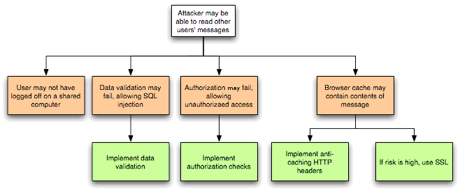
A Threat Tree Example

Slide 38
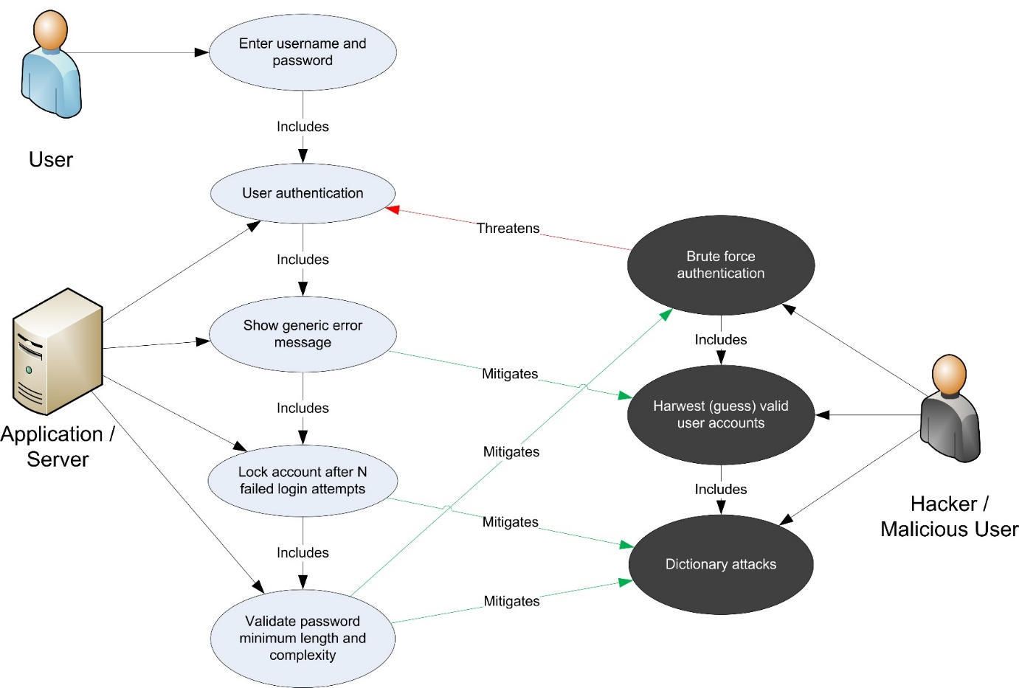
Use Case with Abuse Case

Slide 39
Abuse case example
Assume system administrator identity
Disgruntled
Employee
Tamper with client data
Tamper with application
Exploit poor account management
Exploit poor password management
Script
Kiddie
Exploit OS vulnerability
Install software sniffer
Install hardware sniffer
Hostile
Competitor

Slide 40
Sample: Perform Risk Assessment
There are two essential assets in this system.
The first is the Windows Server computer, which houses the majority of the production system’s intellectual assets (that is, the code that runs the system). This computer acts as a server that allows remote users to access the Asset Management System.
The second essential asset is the information inside the Windows Server computer—specifically, the files stored in the Microsoft IIS server and the information stored in the Sybase database and MapGuide database are critical for making informed decisions. If this information is lost or compromised, the ability to make accurate decisions is lost.

Slide 41
Elicitation Methods
Misuse/Abuse cases:
Misuse/abuse cases apply the concept of a negative scenario—that is, a situation that the system’s owner does not want to occur—in a use-case context. Business leaders, military planners, and game players are familiar with the strategy of analyzing their opponents’ best moves as identifiable threats
QFD
As per Dr. Yoji Akao, who originally developed Quality Function Deployment (QFD) in Japan in 1966, it is a “method to transform qualitative user demands into quantitative parameters, to deploy the functions forming quality, and to deploy methods for achieving the design quality into subsystems and component parts, and ultimately to specific elements of the process”
Joint Application Development (JAD)
The JAD methodology [Wood 1995] involves all stakeholders via highly structured and focused meetings. In the preliminary phases of JAD, the requirements engineering team is charged with fact-finding and information-gathering tasks. Typically, the outputs of this phase, as applied to security requirements elicitation, are security goals and artifacts. The actual JAD session is then used to validate this information by establishing an agreed-on set of security requirements for the product.

Slide 42
Sample: Elicit and Categorize Security Requirements
Security requirements are identified and then organized to map to the high-level security goals (from Step 2).
Examples include :
Requirement 1: The system is required to have strong authentication measures in place at all system gateways and entrance points (maps to Goals 1 and 2).
Requirement 2: The system is required to have sufficient means to govern which system elements (e.g., data, functionality) users can view, modify, and/or interact with (maps to Goals 1 and 2).
Requirement 3: A continuity of operations plan (COOP) is required to assure system availability (maps to Goal 3).

Slide 43
Incorporating SQUARE in SDLC
All nine steps of SQUARE fall under the requirements analysis and specification phase.
The software requirements specification (SRS) should accommodate the outcome of the first eight SQUARE steps
The SRS must clearly specify the security definitions agreed on (Step 1). It is necessary to document security goals (Step 2) along with the project goals and constraints. Develop artifacts (Step 3) such as misuse cases and scenarios to support security requirements definition
Categorize the security requirements (Step 7) and prioritize them (Step 8) along with documented functional requirements. (For clarity, it is preferable to separate security requirements from functional requirements.)

Slide 44
Thank You!

Slide 45
SS ZG 566 Secure Software Engineering
T V Rao

Slide 46
OWASP Recommendations RL 4.3.1

Slide 47
OWASP SAMM
SAMM (Security Assessment Maturity Model) divides activities associated with software development into 4 business functions for incorporating security
Governance
Includes strategy, metrics, policy, compliance, education and guidance
Construction
Includes threat assessment, security requirements, and security architecture
Verification
Includes design review, implementation review, and security testing
Operations
Includes issue management, environment hardening, operational enablement

Slide 48
SAMM Security Requirements
SAMM expects the following as part of security requirements:
Consider security explicitly during the software requirements process
Increase granularity of security requirements derived from business logic and known risks.
Mandate security requirements process for all software projects and third-party dependencies.

Slide 49
Consider security explicitly
(during the software requirements process)
Objective | Activities | Assessment | Results
Consider security explicitly during the software requirements process. | Derive security requirements from business functionality Evaluate security and compliance guidance for requirements | Do project teams specify security requirements during development? Do project teams pull requirements from best practices and compliance guidance? | High-level alignment of development effort with business risks Ad hoc capturing of industry best-practices for security as explicit requirements Awareness amongst stakeholders of measures being taken to mitigate risk from software

Slide 50
Increase granularity
(of security requirements derived from business logic and known risks)
Objective | Activities | Assessment | Results
Increase granularity of security requirements derived from business logic and known risks. | Build an access control matrix for resources and capabilities (e.g. For data resources, it will be in terms of creation, read, update, and deletion) Specify security requirements based on known risks | Do stakeholders review access control matrices for relevant projects? Do project teams specify requirements based on feedback from other security activities? | Detailed understanding of attack scenarios against business logic Prioritized development effort for security features based on likely attacks More educated decision-making for tradeoffs between features and security efforts Stakeholders that can better avoid functional requirements that inherently have security flaws

Slide 51
Mandate security requirements process
(for all software projects and third-party dependencies)
Objective | Activities | Assessment | Results
Mandate security requirements process for all software projects and third-party dependencies. | A. Build security requirements into supplier agreements B. Expand audit program for security requirements | Do stakeholders review vendor agreements for security requirements? Are audits performed against the security requirements specified by project teams? | Formally set baseline for security expectations from external code Centralized information on security effort undertaken by each project team Ability to align resources to projects based on application risk and desired security requirements

Slide 52
Assessment Matrix for Security Requirements
Score -> | 0.0 | 0.2 | 0.5 | 1.0
Do project teams specify security requirements during development? | No | Some | Half | Most
Do project teams pull requirements from best practices and compliance guidance? | No | Per Team | Org wide | Integrated Process
Do stakeholders review access control matrices for relevant projects? | No | Some | Half | Most
Do project teams specify requirements based on feedback from other security activities? | No | Some | Half | Most
Do stakeholders review vendor agreements for security requirements? | No | Some | Half | Most
Are audits performed against the security requirements specified by project teams? | No | Once | Every 2-3 years | Annual

Slide 53
Thank You!

Slide 54
SS ZG 566 Secure Software Engineering
T V Rao

Slide 55
SDL Recommendations RL 4.3.2

Slide 56
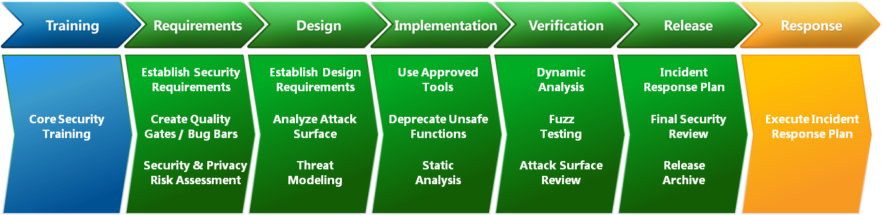
Security Development Lifecycle (SDL)

Slide 57
SDL Requirements Practices
The major SDL practices during requirements analysis are
Establish Security & Privacy Requirements
Create Quality Gates/Bug Bars
Create Security/Privacy Risk Assessments

Slide 58
Establish Security & Privacy Requirements
Define and integrate security and privacy requirements early
identify key milestones and deliverables and minimize disruptions to plans and schedules.
Security and privacy analysis including
assigning security experts,
defining minimum security and privacy criteria for an application, and
deploying a security vulnerability/work item tracking system.
When should this practice be implemented?
Traditional Software development: Requirements Phase
Agile development: One Time

Slide 59
Create Quality Gates/Bug Bars
Defining minimum acceptable levels of security and privacy quality
the team understand risks associated with security issues,
Team identifies and fixes security bugs during development, and
Team apply the standards throughout the entire project.
Set a bug bar to clearly define the severity thresholds of security vulnerabilities
(for example, no known vulnerabilities in the application with a “critical” or “important” rating at time of release)
When should this practice be implemented?
Traditional Software development: Requirements Phase
Agile development: One Time

Slide 60
Security/Privacy Risk Assessments
Identify portions of a project requiring threat modeling and security design reviews before release
Determine the Privacy Impact Rating of a feature, product, or service
When should this practice be implemented?
Traditional Software development: Requirements Phase
Agile development: One Time

Slide 61
Software Security Engineering, Julia H. Allen, et al, Pearson, 2008.
Security in Computing by Charles P. Pfleeger, Shari L. Pfleeger, and Deven Shah Pearson Education 2009
Computer Security: Principles and Practice by William Stallings, and Lawrie Brown Pearson, 2008.
www.owasp.com
www.microsoft.com

Slide 62
Thank You!

